Slide 1
Some Ideas about Category Theory
Mingyi Xu
Mentor: Daniel Wallick

Slide 2
Overview of Contents
What is Category Theory
Isomorphism
Monics and Epics
Initial and Terminal Objects
Products and Coproducts
My Feelings

Slide 3
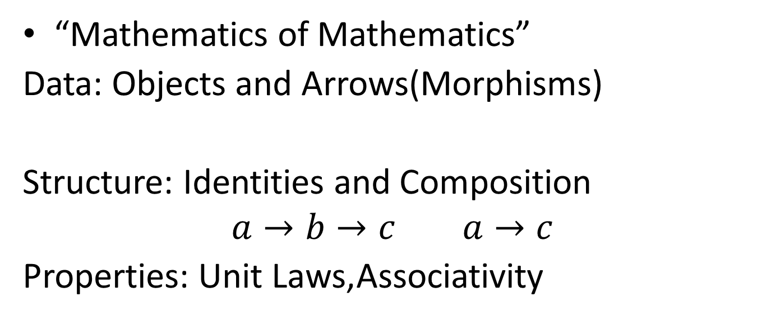
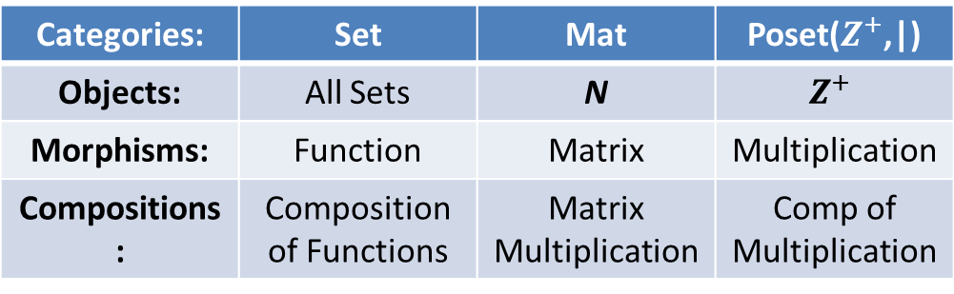
What is Category Theory
“Mathematics of Mathematics”
Data: Objects and Arrows(Morphisms)
Structure: Identities and Composition
$$a→b→c a→c$$
Properties: Unit Laws,Associativity
Categories: | Set | Mat | Poset($Z^{+}$,|)
Objects: | All Sets | N | $$Z^{+}$$
Morphisms: | Function | Matrix | Multiplication
Compositions: | Composition of Functions | Matrix Multiplication | Comp of Multiplication

Slide 4
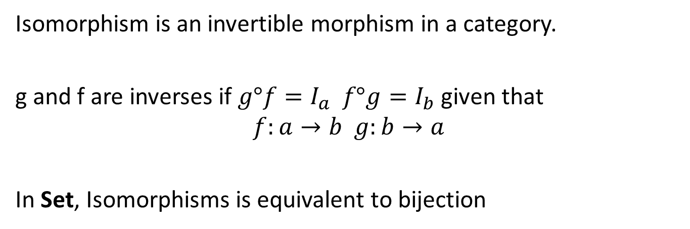
Isomorphism
Isomorphism is an invertible morphism in a category.
g and f are inverses if $g°f=I_{a} f°g=I_{b}$ given that
$$f:a→b g:b→a$$
In Set, Isomorphisms is equivalent to bijection
A
B
C
1
2
3
A
B
C
1
2
A
B
C
1
2
3
Injection, 1 has no inverse
Surjection, 1 has no inverse
Bijection, every morphism
is invertible

Slide 5
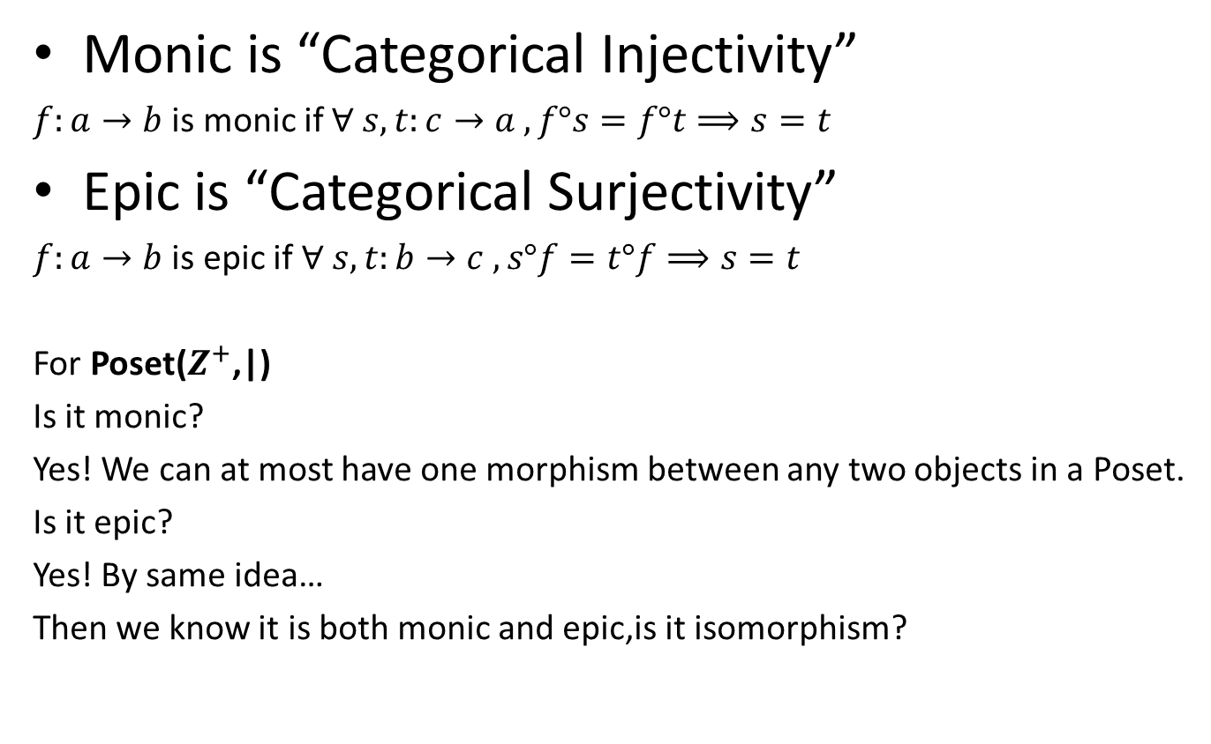
Monics and Epics
Monic is “Categorical Injectivity”
$f:a→b$ is monic if $∀ s,t:c→a , f°s=f°t⟹s=t$
Epic is “Categorical Surjectivity”
$f:a→b$ is epic if $∀ s,t:b→c , s°f=t°f⟹s=t$
For Poset$\text{(}Z^{+}\text{,|)}$
Is it monic?
Yes! We can at most have one morphism between any two objects in a Poset.
Is it epic?
Yes! By same idea…
Then we know it is both monic and epic,is it isomorphism?

Slide 6

Both Monic and Epic does not mean isomorphism in Poset
For Poset$\text{(}Z^{+}\text{,|)}$
Suppose we have 5
By morphism $×2$
We got 10
No Integer to reverse this!

Slide 7
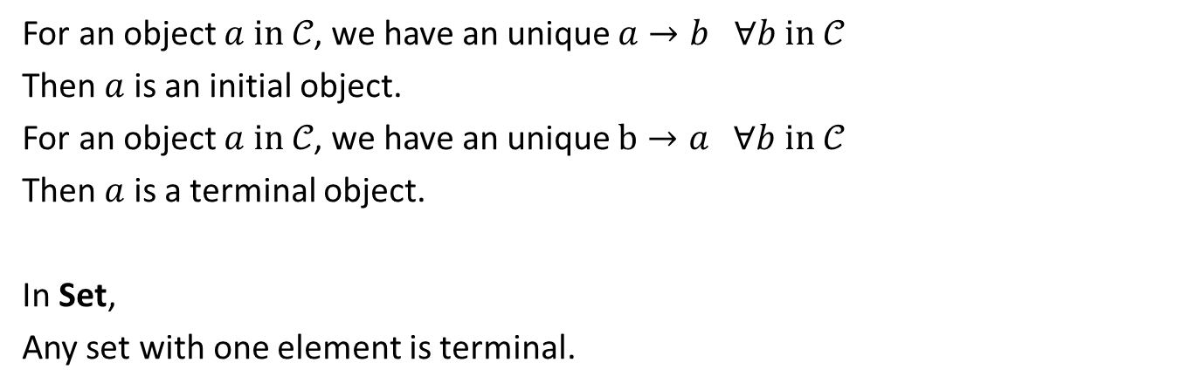
Initial and Terminal Objects
For an object $a in 𝒞$, we have an unique $a→b ∀b in 𝒞$
Then $a$ is an initial object.
For an object $a in 𝒞$, we have an unique $b→a ∀b in 𝒞$
Then $a$ is a terminal object.
In Set,
Any set with one element is terminal.
A
B
C
*
A
B
C
……
*
A
B
C
*
+
A
B
C
*
+

Slide 8
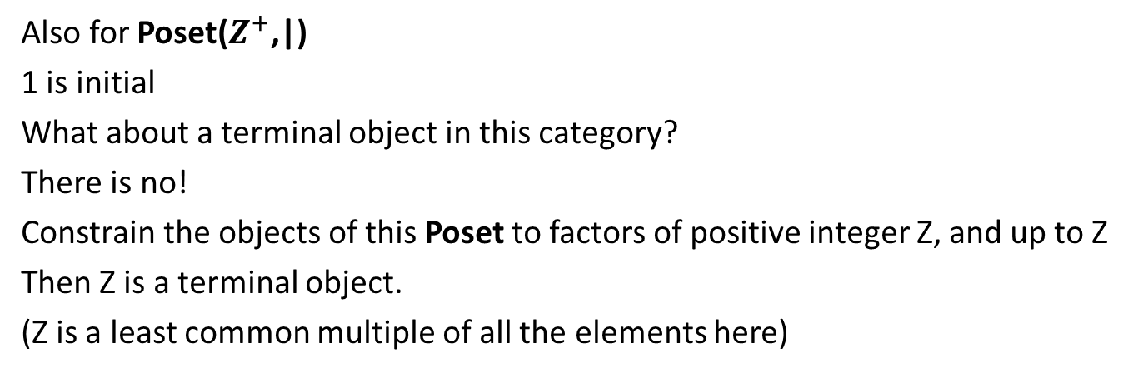
Empty Set is initial.
A
B
C
*
+
A
B
C
*
+
*
+
Only “Empty Function”
Also for Poset$\text{(}Z^{+}\text{,|)}$
1 is initial
What about a terminal object in this category?
There is no!
Constrain the objects of this Poset to factors of positive integer Z, and up to Z
Then Z is a terminal object.
(Z is a least common multiple of all the elements here)

Slide 9
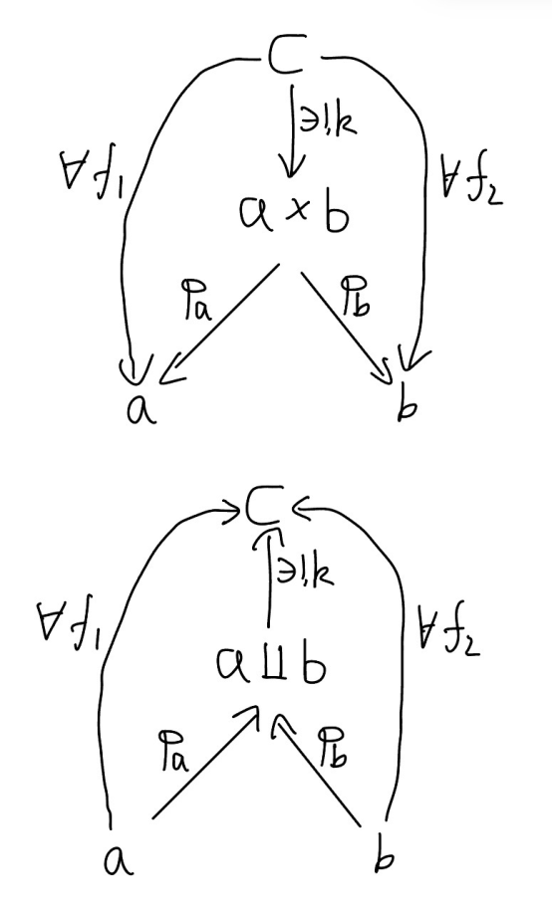
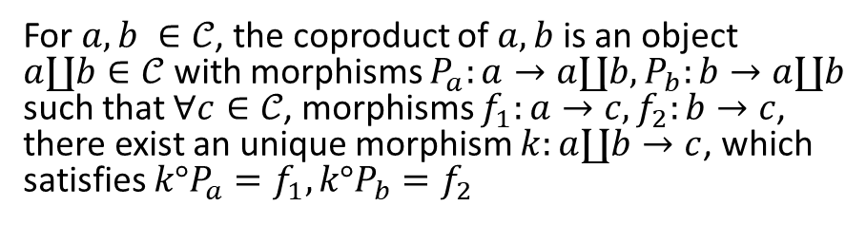
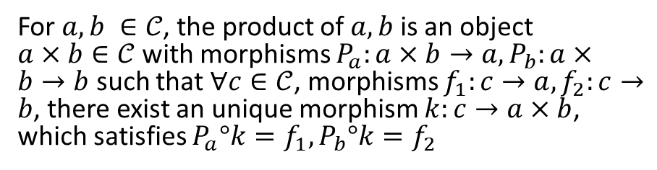
Products and Coproducts
For $a,b ∈𝒞$, the product of $a, b$ is an object $a×b∈𝒞$ with morphisms $P_{a}:a×b→a, P_{b}:a×b→b$ such that $∀c∈𝒞$, morphisms $f_{1}:c→a, f_{2}:c→b$, there exist an unique morphism $k:c→a×b$, which satisfies $P_{a}°k=f_{1}, P_{b}°k=f_{2}$
For $a,b ∈𝒞$, the coproduct of $a, b$ is an object $a∐b∈𝒞$ with morphisms $P_{a}:a→a∐b, P_{b}:b→a∐b$ such that $∀c∈𝒞$, morphisms $f_{1}:a→c, f_{2}:b→c$, there exist an unique morphism $k:a∐b→c$, which satisfies ${k°P}_{a}=f_{1}, k°P_{b}=f_{2}$

Slide 10
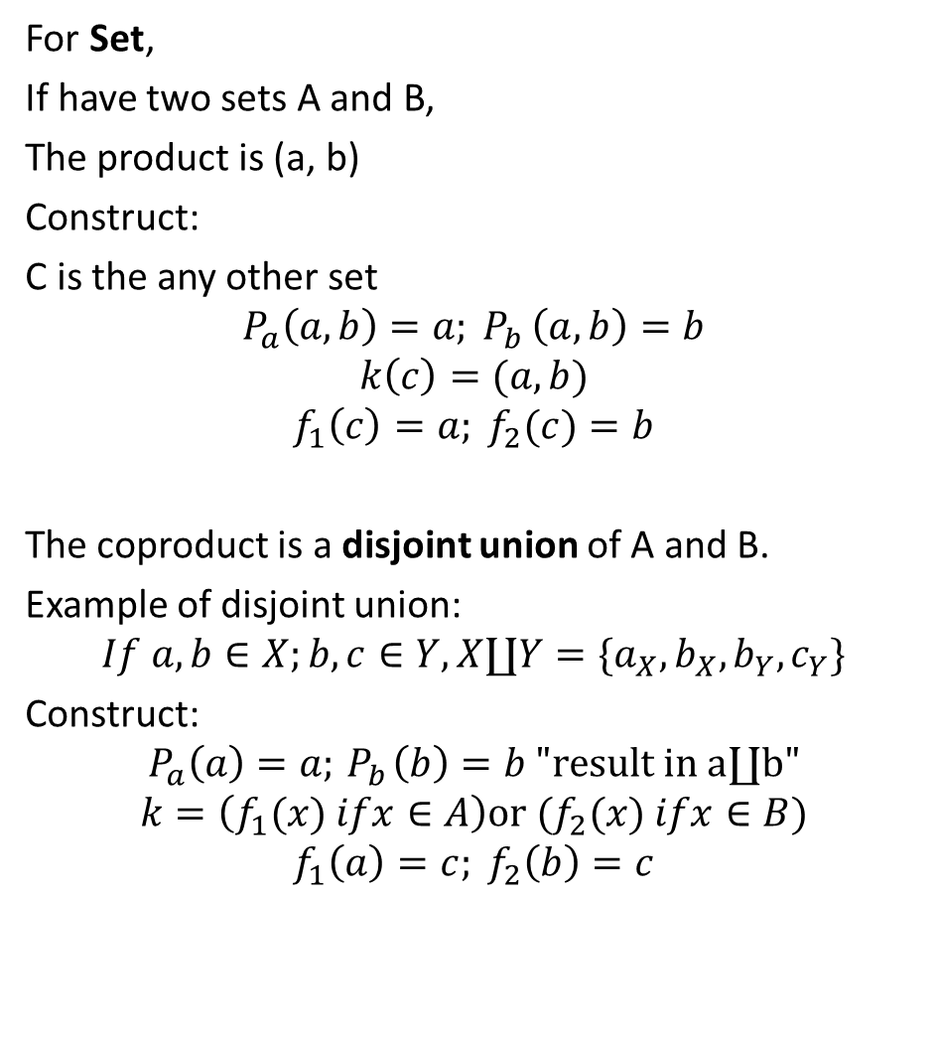
For Set,
If have two sets A and B,
The product is (a, b)
Construct:
C is the any other set
$$P_{a}\left(a, b\right)=a{; P}_{b}\left(a, b\right)=b$$
$$k\left(c\right)=(a,b)$$
$$f_{1}\left(c\right)=a; f_{2}(c)=b$$
The coproduct is a disjoint union of A and B.
Example of disjoint union:
$$If a,b∈X;b,c∈Y,X∐Y=\{a_{X},b_{X},b_{Y},c_{Y}\}$$
Construct:
$$P_{a}\left(a\right)=a;{ P}_{b}\left(b\right)=b "result in a∐b"$$
$$k=\left(f_{1}(x) ifx∈A\right)or (f_{2}(x) ifx∈B)$$
$$f_{1}\left(a\right)=c; f_{2}\left(b\right)=c$$

Slide 11
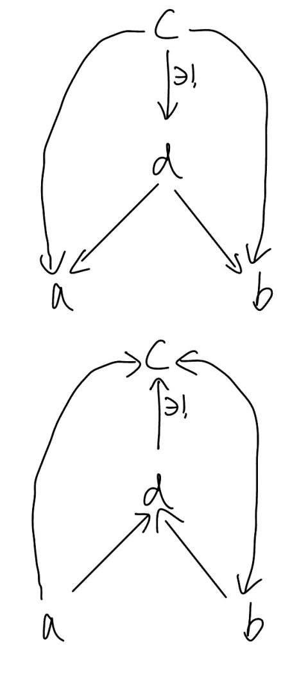
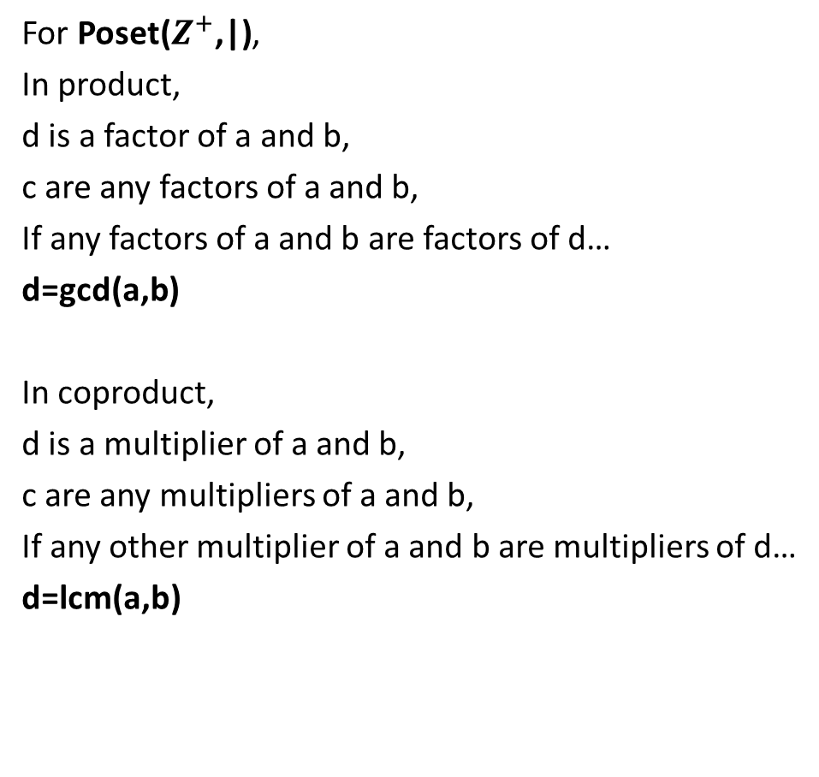
For Poset$\text{(}Z^{+}\text{,|)}$,
In product,
d is a factor of a and b,
c are any factors of a and b,
If any factors of a and b are factors of d…
d=gcd(a,b)
In coproduct,
d is a multiplier of a and b,
c are any multipliers of a and b,
If any other multiplier of a and b are multipliers of d…
d=lcm(a,b)

Slide 12
The book I read is The Joy Of Abstraction – An Exploration of Math, Category Theory, and Life by Eugenia Cheng
Really Good Book:
Introduced some background knowledge
Used easy understanding examples
Also I am really thankful to my mentor Daniel.
Thanks!

